Slide 1



Slide 2
Let’s go back in time

Slide 3
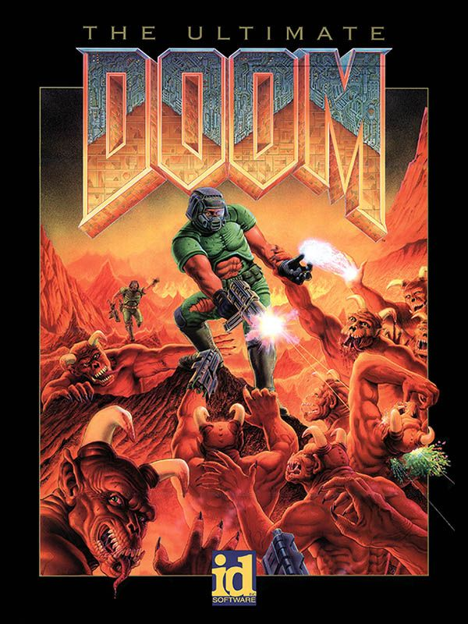
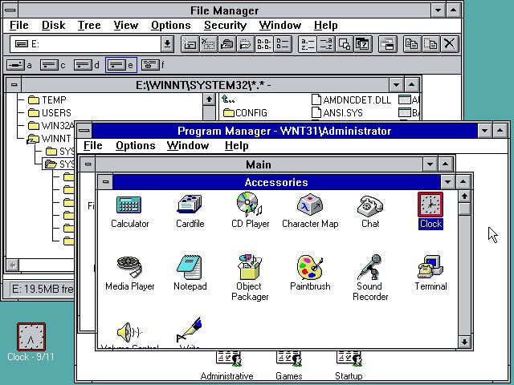
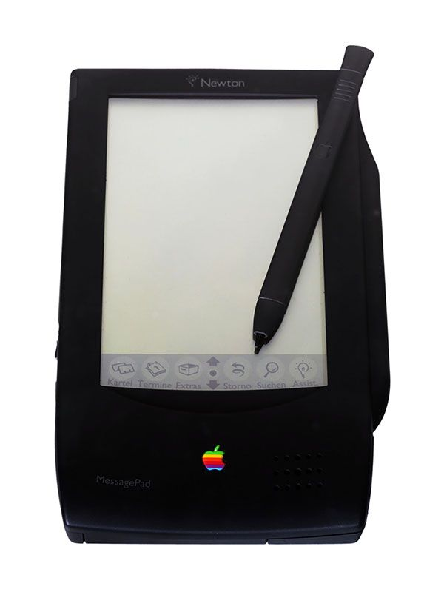
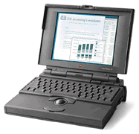
1993 was great time in Tech!
DOOM
MICROSOFT WINDOWS NT
APPLE NEWTON
APPLE POWERBOOK 150
4M RAM
500M HD
Notes:
Doom – first multiplayer shoot game, introduced ‘modding’
Microsoft NT
Apple Powerbook 150 – first with color screen, 4M RAM, 500M hard drive
Apple Newton – early tablet, hand poor handwriting recognition

Slide 4

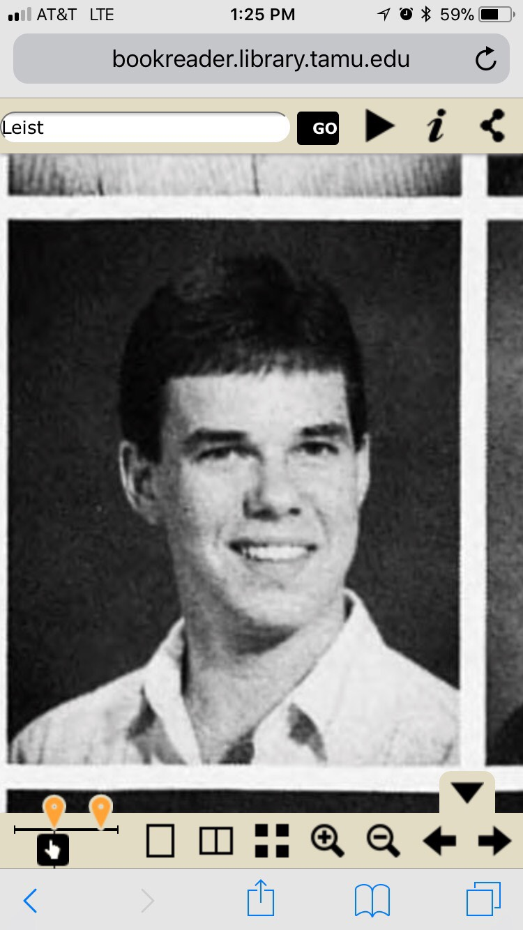
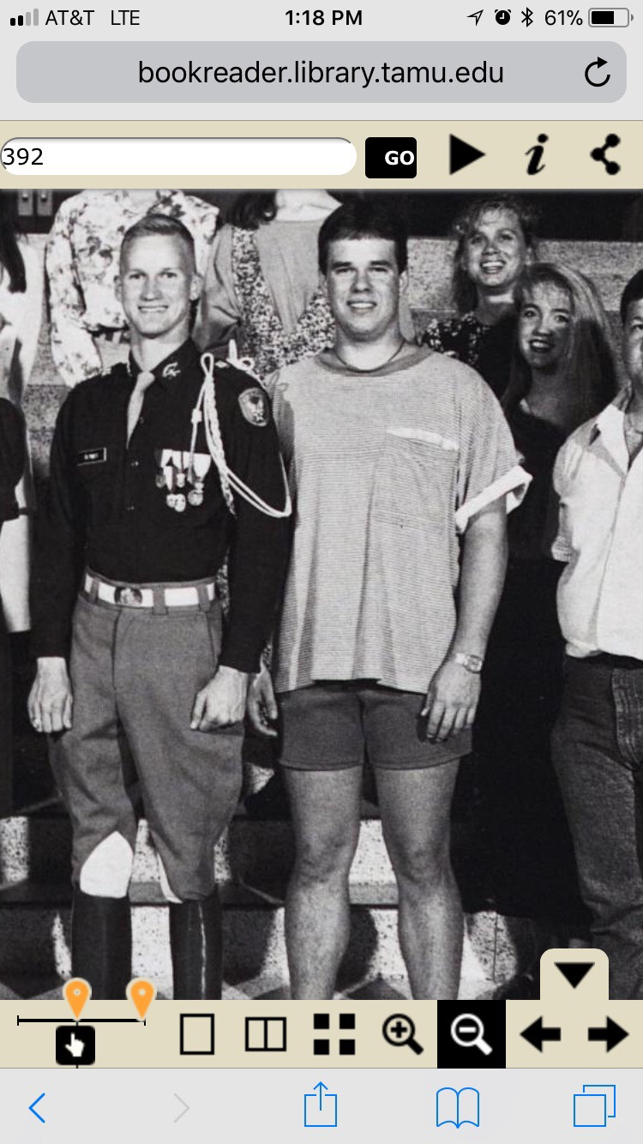
Best education – great future!
CLASS OF
1993
Notes:
Doom – first multiplayer shoot game, introduced ‘modding’
Microsoft NT
Apple Powerbook 150 – first with color screen, 4M RAM, 500M hard drive
Apple Newton – early tablet, hand poor handwriting recognition

Slide 5
Now fast forward >>>

Slide 6

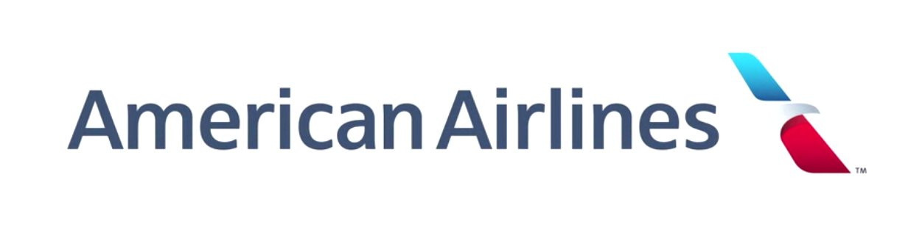
2018 – Best job ever!
Steven Leist
VP - Customer Technology & Enterprise Architecture
Notes:
Doom – first multiplayer shoot game, introduced ‘modding’
Microsoft NT
Apple Powerbook 150 – first with color screen, 4M RAM, 500M hard drive
Apple Newton – early tablet, hand poor handwriting recognition

Slide 7
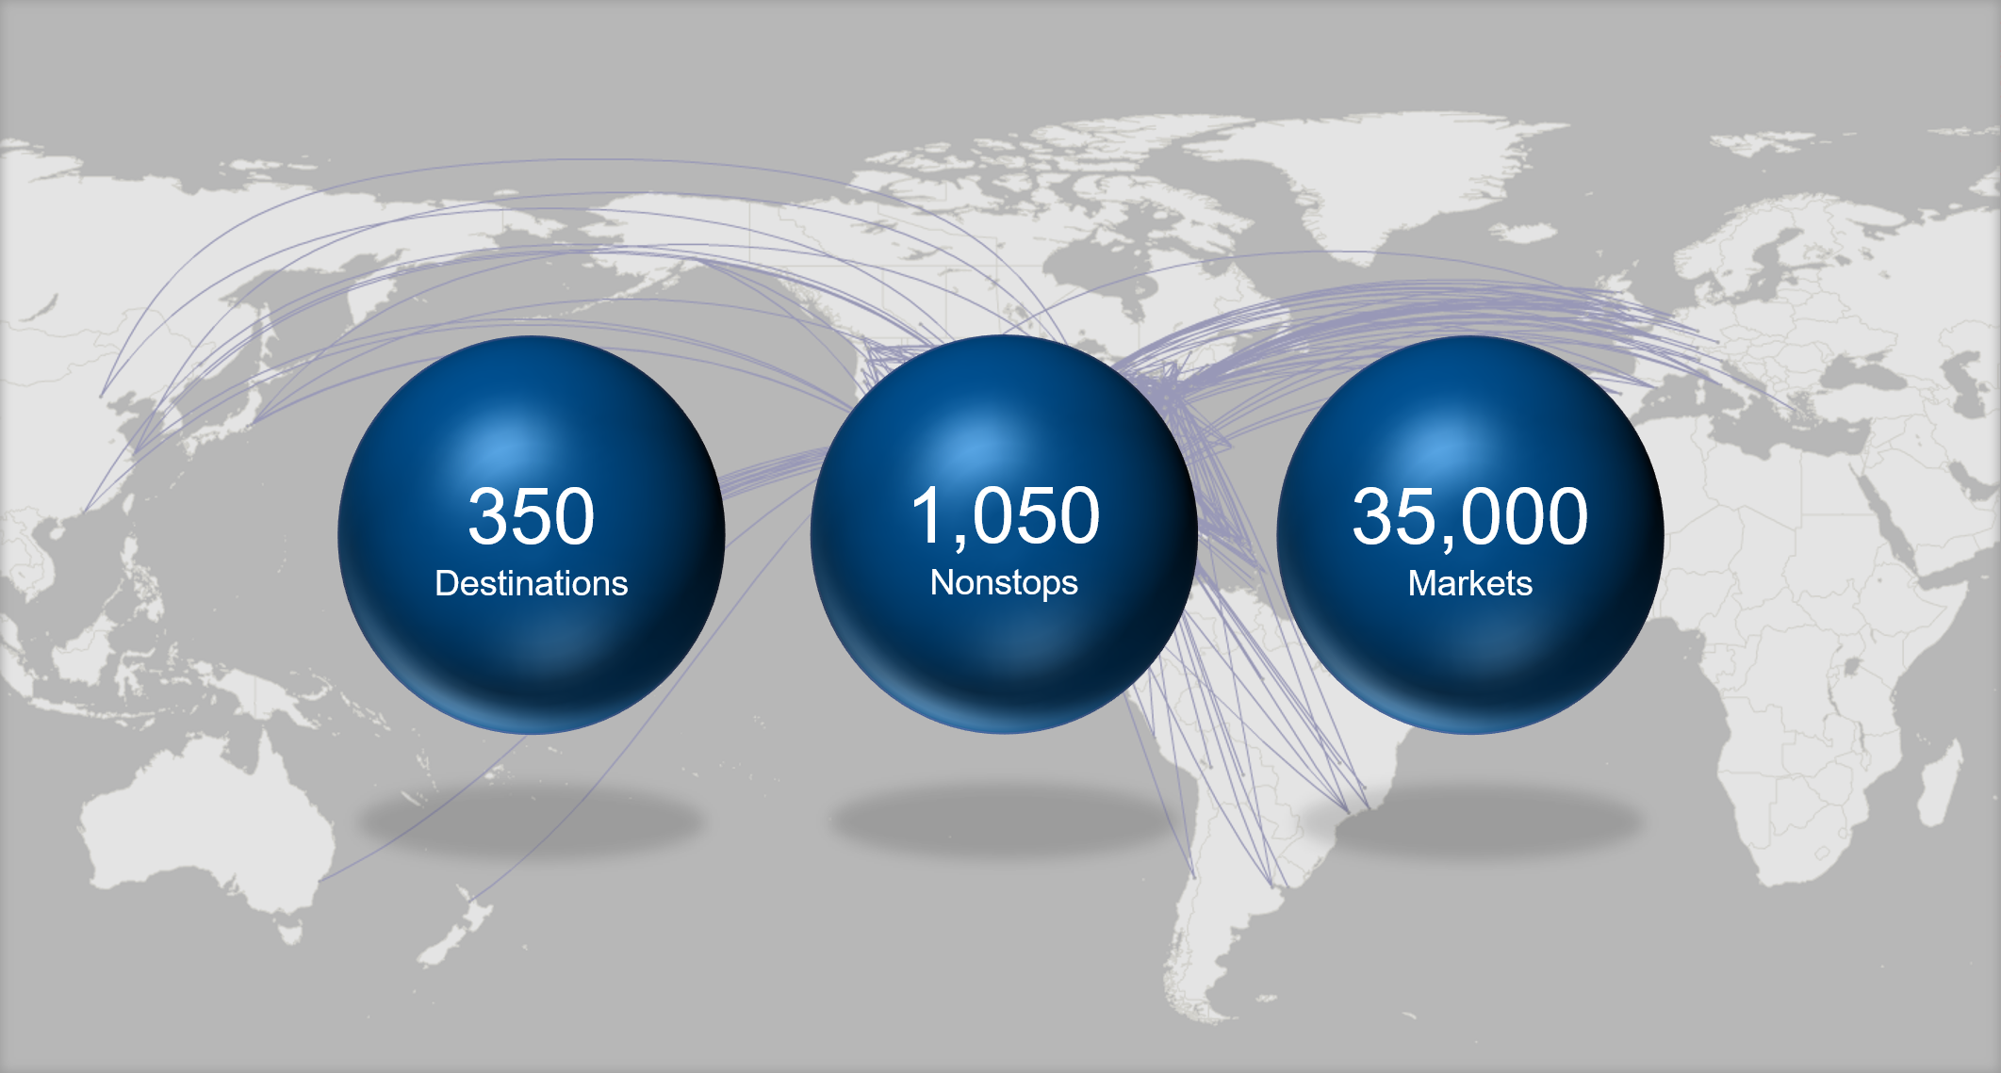
World’s Largest Airline

Slide 8
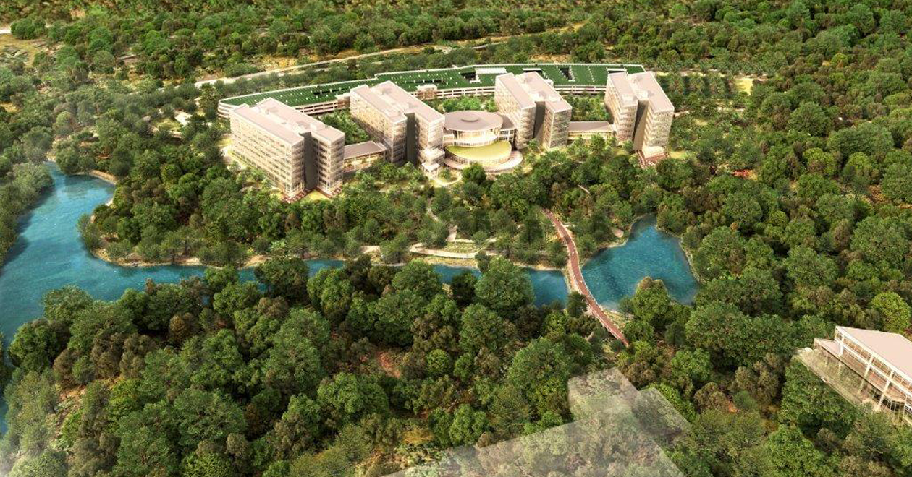
New campus opens 2019

Slide 9
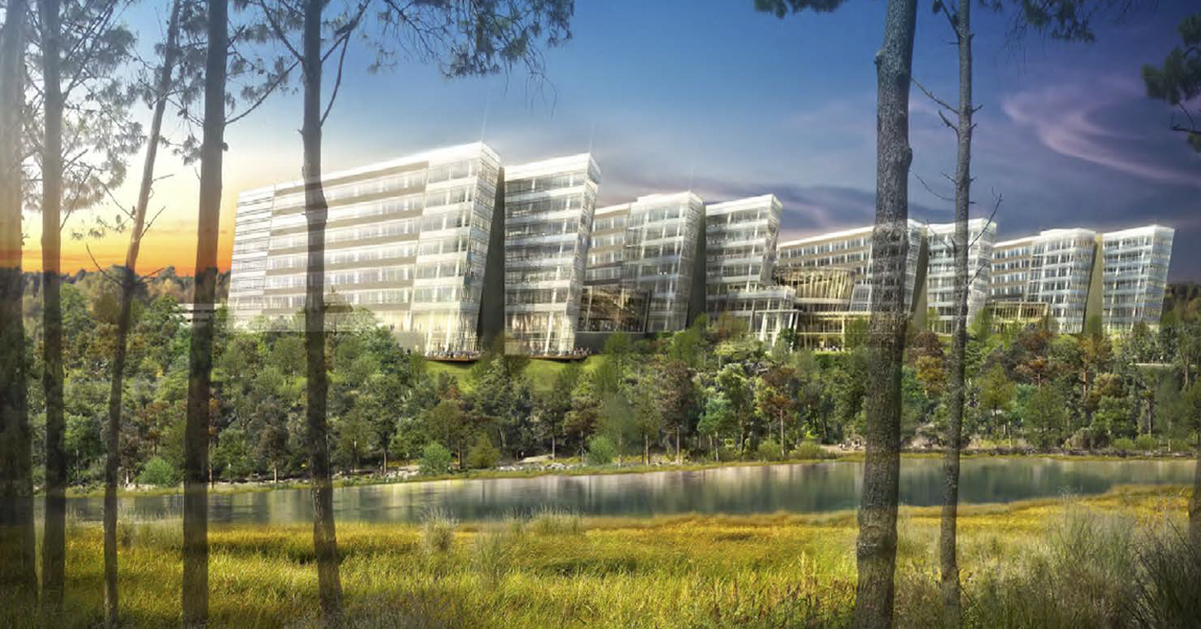

Slide 10
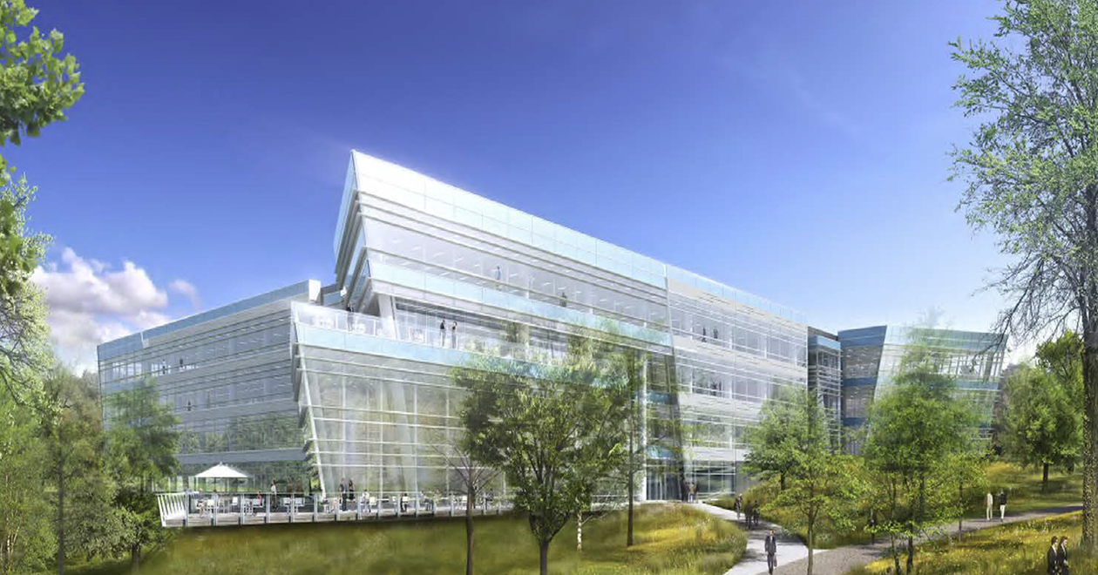

Slide 11
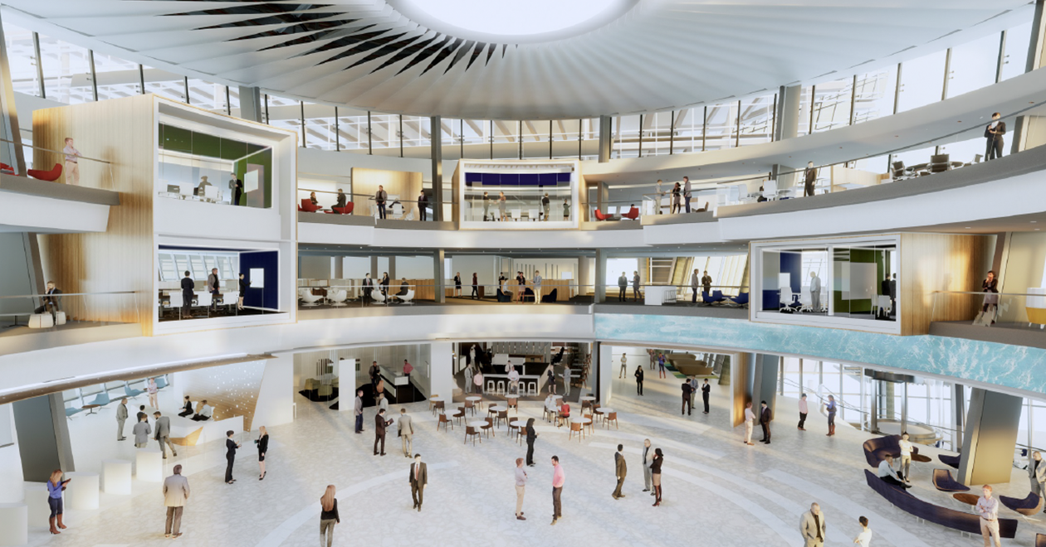

Slide 12
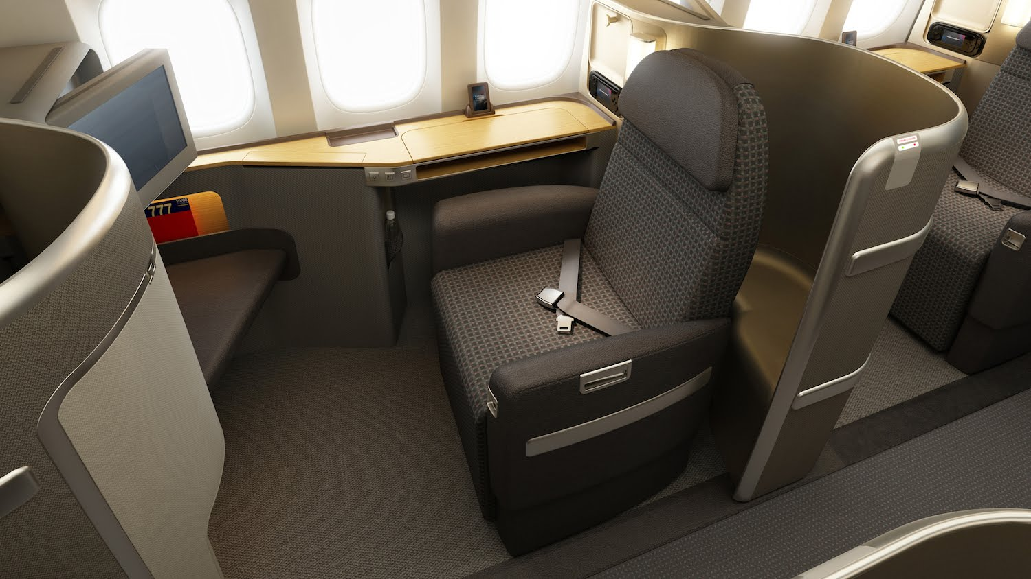
The Jetsetter Lifestyle

Slide 13
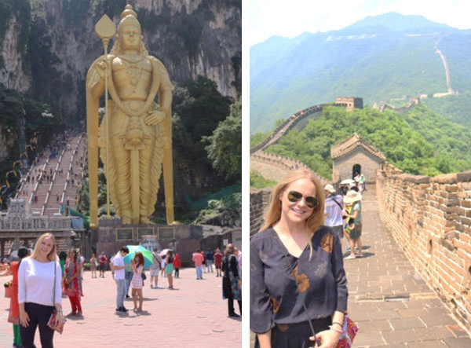
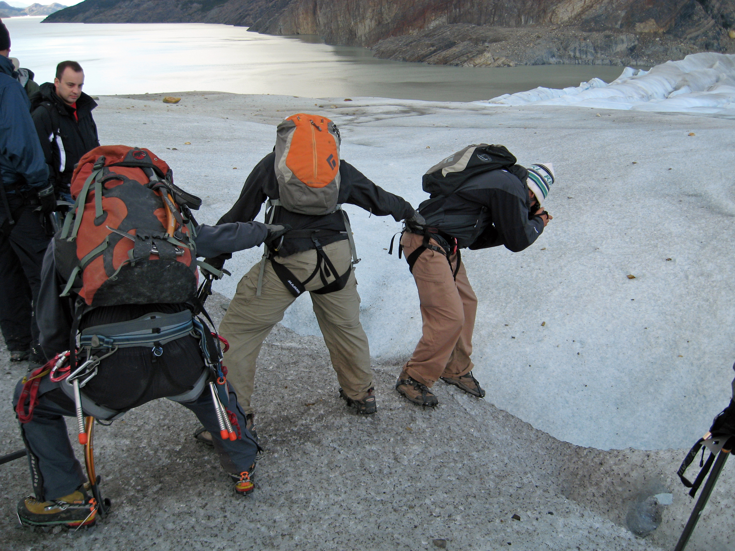
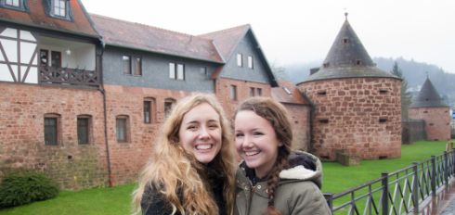
We love to travel

Slide 14












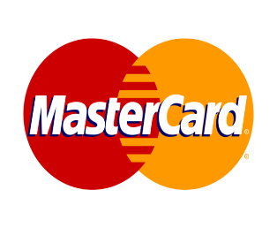




American Tech

Slide 15
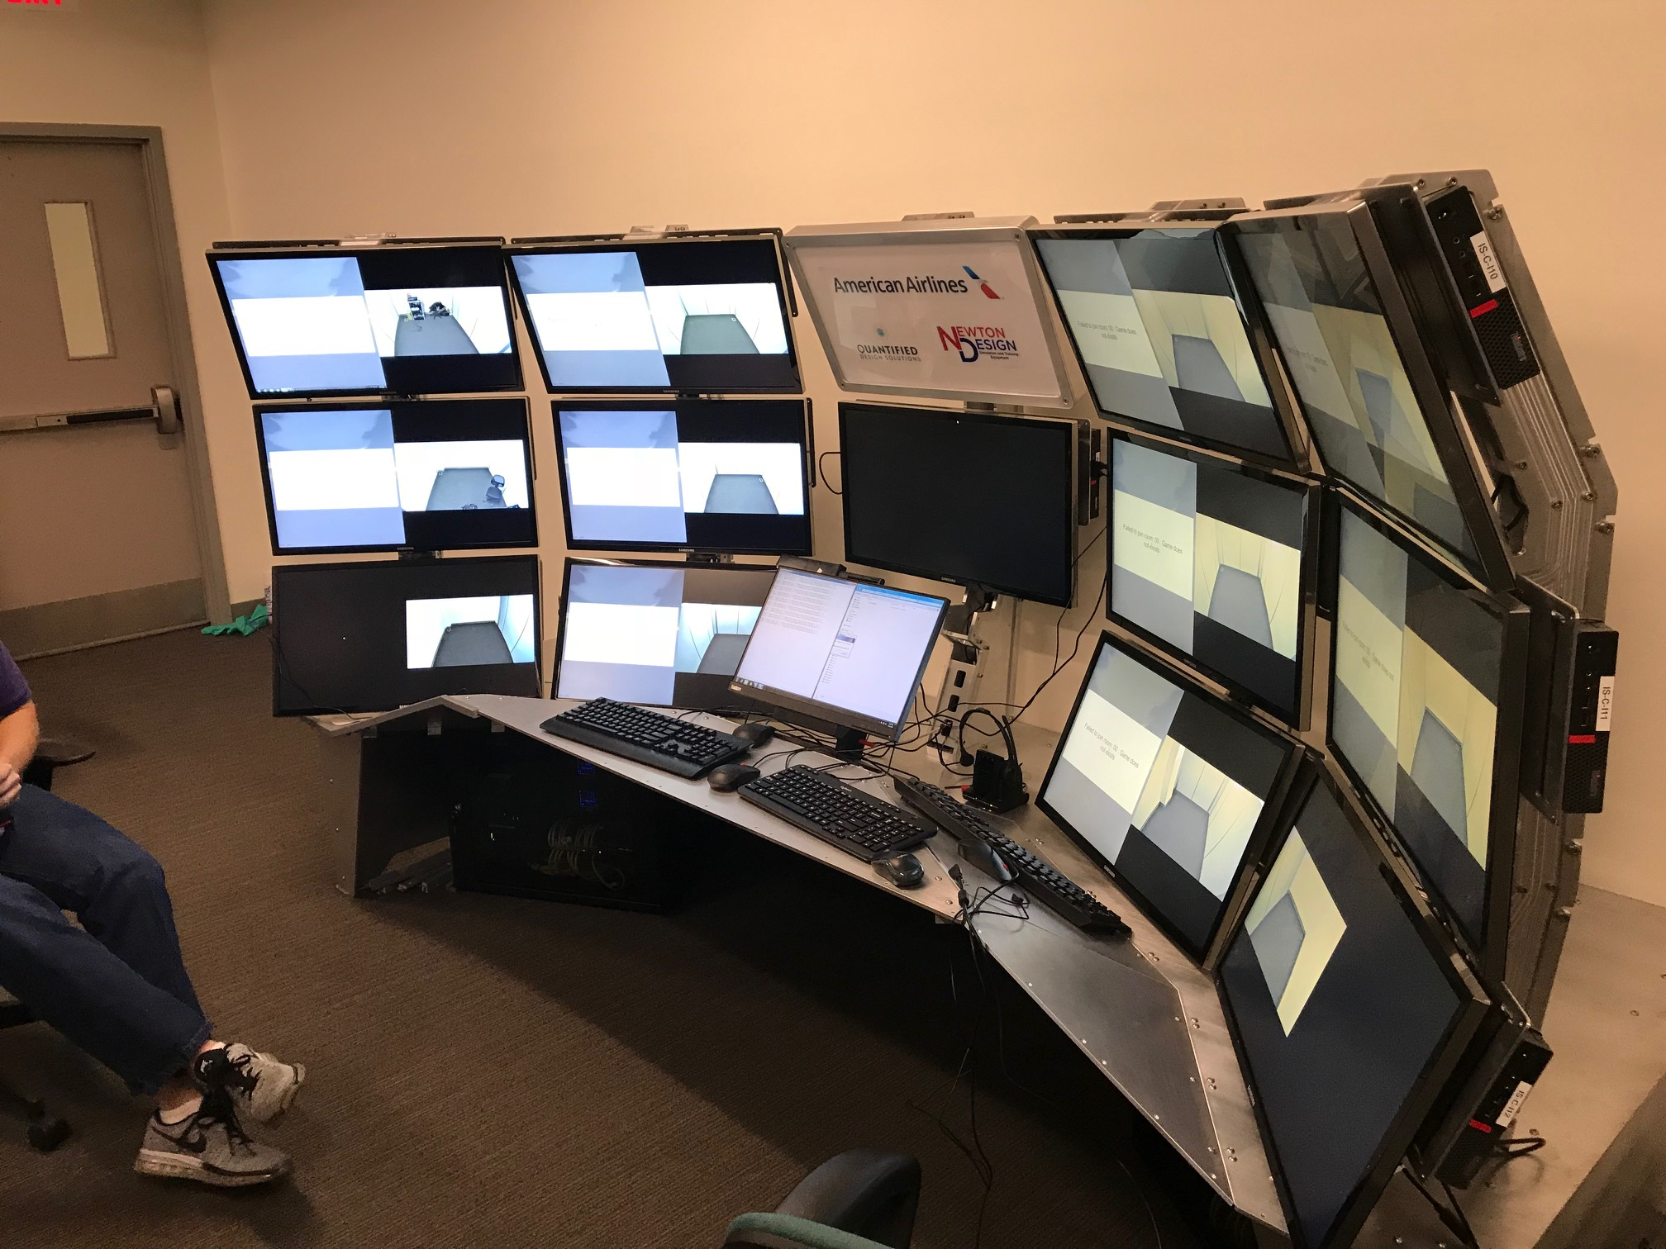
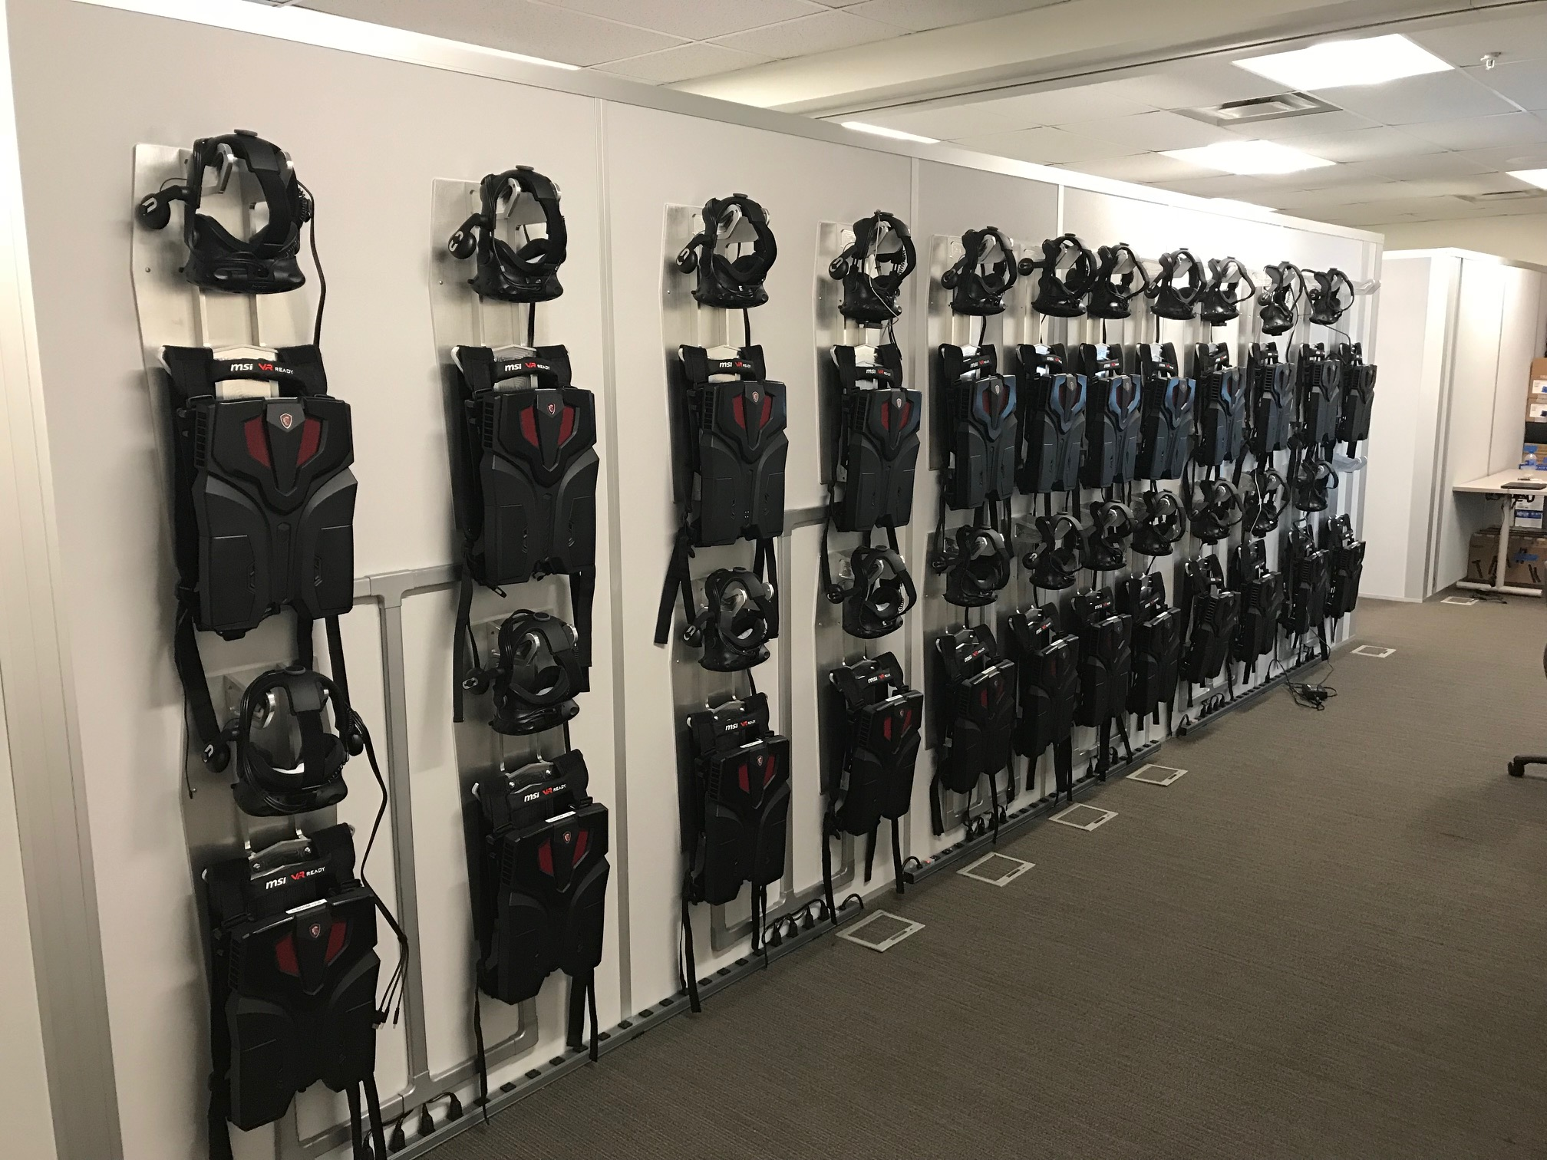
Cool Projects
at American
First airline to train Employees using
Virtual Reality

Slide 16
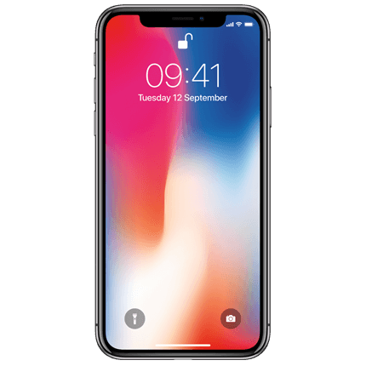
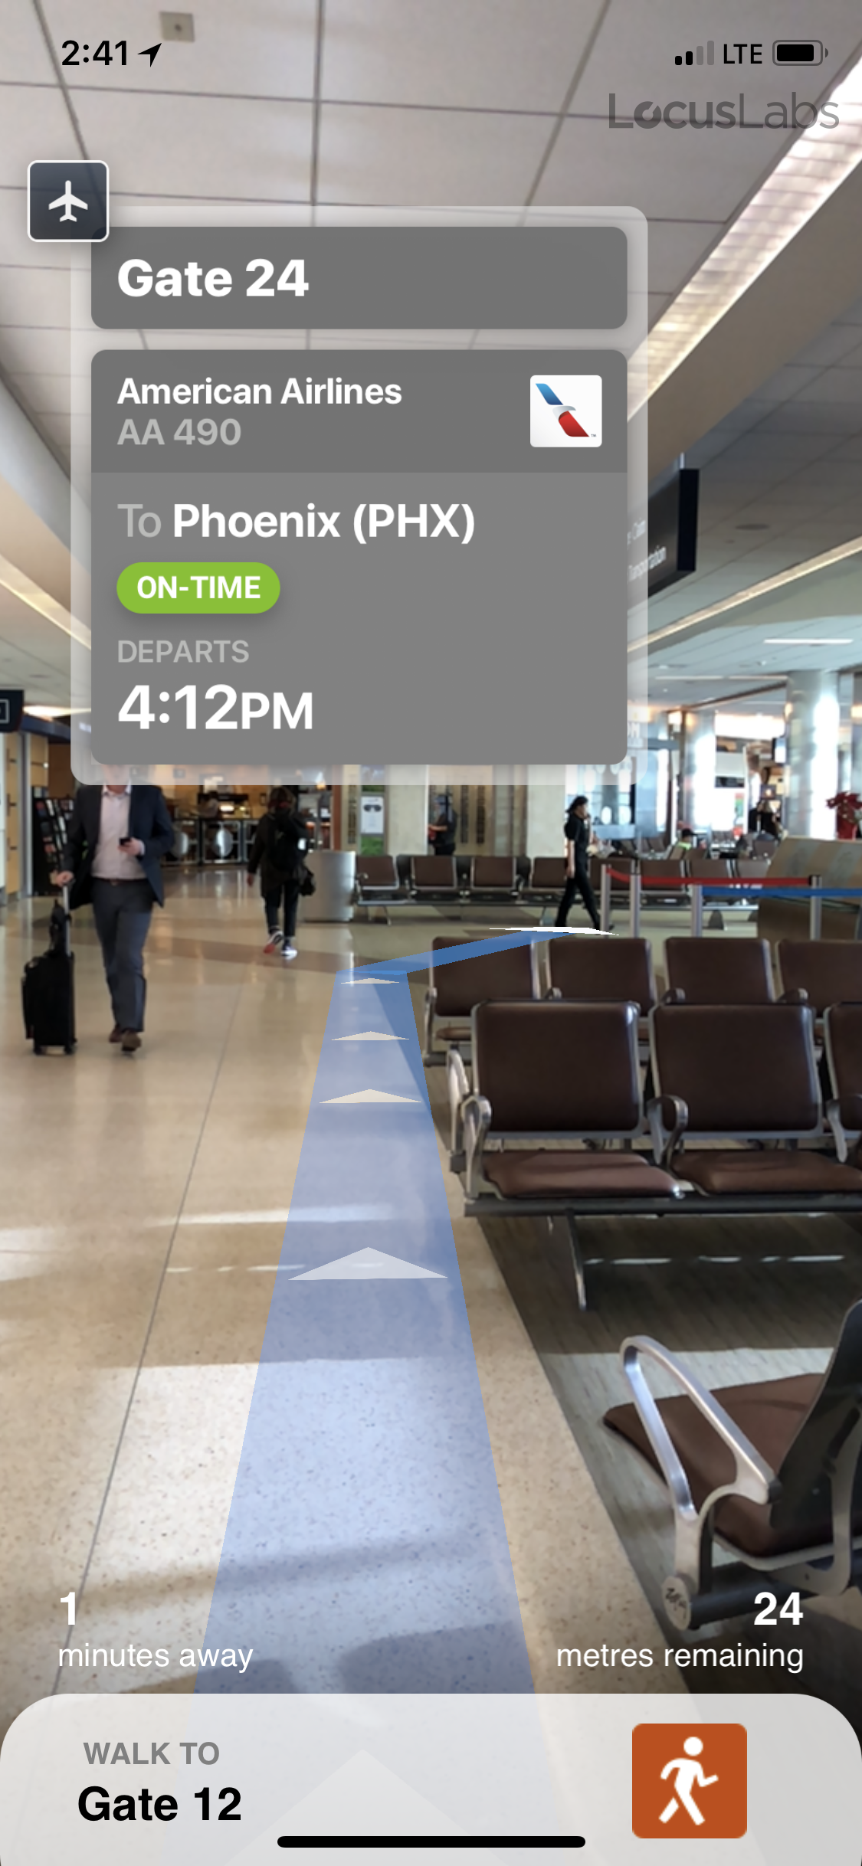
Cool Projects
at American
First airline to use
Augmented Reality
to provide real-time
navigation

Slide 17
Tech and Prizes
Workshop: | “Up in the Air” – learn about our APIs and ask experts about our business and customers
Challenge: API: | bit.ly/aahack bit.ly/aamock
Themes: | Enhance the customer experience Help our Employees Improve our Brand image
First Place: | 2 tickets Europe OR 1 ticket to Asia/Pacific
Second Place: | 2 tickets USA
Third Place: | 1 ticket USA

